Slide 1
Tree-Structured Indexes
SUN YAT-SEN UNIVERSITY

Slide 2
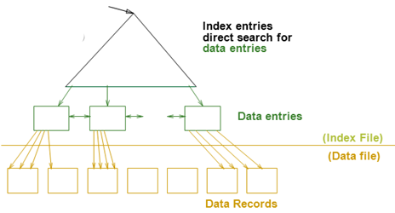
Review
Cost Model（代价模型）
  只关心磁盘块的IO次数
    文件由页组成，而每个页包含一组记录
    Record id = <page id, slot #>
    从随机访问的角度来说，读写一条记录需要一次磁盘IO。
索引技术概述
  可以为关系建立索引，都是文件
  索引文件由两部份组成
    数据项部分
      Data Entry(数据项) data record（数据记录）
    引导部份
      树索引技术
      Hash索引

Slide 3
Tree-Structured Indexes: Introduction
Selections of form: field <op> constant
  Equality selections (op is =)
    Either “tree” or “hash” indexes help here.
  Range selections (op is one of <, >, <=, >=, BETWEEN)
    “Hash” indexes don’t work for these.
Tree-structured indexing techniques support both equality selections and range selections.
  ISAM(索引顺序存取方法): static structure; early index technology.
  B+ tree: dynamic, adjusts gracefully under inserts and deletes.
Notes:
2

Slide 4
Range Searches
``Find all students with gpa > 3.0’’
  If data is in sorted file, do binary search to find first such student, then scan to find others.
  Cost of binary search in a database can be quite high.
    Why???
Simple idea: Create an `index’ file.
索引项 <search key value of first record, page id>
k₁
k₂
k_{N}
Index File
分隔符
(…, k₁)
[k₁, k₂)
[k₂, …)
[k_{N}, …)
Page 1
Page 2
Page 3
Page N
排序的 Data File
Can do binary search on (smaller) index file!
Notes:
3

Slide 5
ISAM
index entry（分隔符）
P
K
P
K
2
P
K
P
m
0
1
1
2
m
(…, k₁)
[k₁, k₂)
[k₂, …)
[k_{m}, …)
Index file may still be quite large. But we can apply the idea repeatedly!
索引树：节点=Page
Non-leaf
Pages
Leaf
Pages
Overflow
page
Primary pages
Leaf pages contain data entries.
Notes:
4

Slide 6
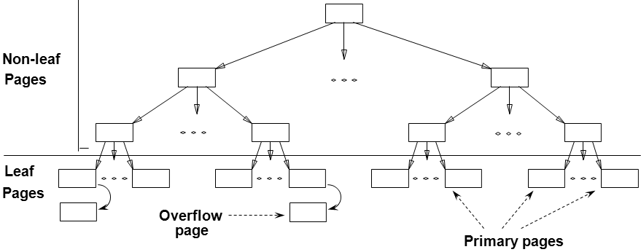
ISAM is a STATIC Structure
Data Pages
File creation:
  Leaf (data) pages allocated sequentially, sorted by search key
  then index pages
  then overflow pgs.
Search: Start at root; use key comparisons to go to leaf.
Cost = log _{F} N
  F = # entries/page (i.e., fanout 扇出)
  N = # leaf pages
  no need for `next-leaf-page’ pointers. (Why?)
Insert: Find leaf that data entry belongs to, and put it there. Overflow page(溢出页) if necessary.
Delete: Seek and destroy! If deleting a tuple empties an overflow page, de-allocate it and remove from linked-list.
Index Pages
Page Number
Overflow pages
Static tree structure: inserts/deletes affect only leaf pages.
Notes:
5

Slide 7
Example ISAM Tree
Example where each node can hold 2 entries;
Index entries: <search key value, page id>, they direct search for data entries in leaves.
分隔符
Root
40
(…, 40)
[40, …)
20
33
51
63
[33, …)
[63, …)
(…, 20)
[20, 33)
(…, 51)
[51, 63)
10*
15*
20*
27*
33*
37*
40*
46*
51*
55*
63*
97*
Notes:
6

Slide 8
Example: Insert 23*, 48*, 41*, 42*
分隔符
Root
Index
40
Pages
(…, 40)
[40, …)
20
33
51
63
(…, 20)
[33, …)
(…, 51)
[63, …)
Primary
[20, 33)
[51, 63)
Leaf
10*
15*
20*
27*
33*
37*
40*
46*
51*
55*
63*
97*
Pages
Overflow溢出页
23*
48*
41*
Pages
42*
Notes:
7

Slide 9
... then Deleting 42*, 51*, 97*
分隔符
Root
Index
40
Pages
(…, 40)
[40, …)
20
33
51
63
(…, 20)
[33, …)
(…, 51)
[63, …)
Primary
[20, 33)
[51, 63)
Leaf
10*
15*
20*
27*
33*
37*
40*
46*
51*
55*
63*
97*
Pages
Overflow
23*
48*
41*
Pages
42*
ISAM is a STATIC Structure
Note that 51 appears in index levels, but not in leaf!
Notes:
7

Slide 10
B+ Tree Structure
Each node contains d <= m <= 2d entries (index or data)
  The parameter d is called the order(秩) of the tree.
  Each internal node contains m index entries: <key, page id>.
  Each leaf node contains m data entries: <key, record or record id>
The ROOT node contains between 1 and 2d index entries.
  It is a leaf or has at least two children.
Each path from the ROOT to any leaf has the same length.
- 平衡树 -- 树的高度
Supports equality and range-searches efficiently.
Index Entries
(Direct search)
Data Entries
("Sequence set")
Notes:
9

Slide 11
B+ Tree Equality Search
Search begins at root, and key comparisons direct it to a leaf.
Search for 15*…
Root
13
17
24
30
分隔符
2*
3*
5*
7*
14*
16*
19*
20*
22*
24*
27*
29*
33*
34*
38*
39*
Based on the search for 15*, we know it is not in the tree!
Notes:
10

Slide 12
B+ Tree Range Search
Search all records whose ages are in [15,28].
  Equality search 15*.
  Follow sibling pointers.
分隔符
Root
13
17
24
30
2*
3*
5*
7*
14*
16*
19*
20*
22*
24*
27*
29*
33*
34*
38*
39*
Notes:
10

Slide 13
B+ Trees in Practice
d <= m <= 2d
Typical order (秩) : 100. Typical fill-factor: 67%.
  average fanout(扇出) = 133 2d*2/3
  Level 1 = 1 page = 8 KB
  Level 2 = 133 pages = 1 MB
  Level 3 = 17,689 pages = 145 MB
  Level 4 = 2,352,637 pages = 19 GB
Can often hold top levels in buffer pool:
With 1 MB buffer, can locate one record in 19 GB (or 0.3 billion records) in two I/Os!

Slide 14
Inserting a Data Entry into a B+ Tree
Find correct leaf L.
Put data entry onto L.
  If L has enough space, done!
  Else, must split (分裂) L (into L and a new node L2)
    Redistribute entries evenly, copy up(复制上去) middle key.
    Insert index entry pointing to L2 into parent of L.
This can happen recursively
  To split index node, redistribute entries evenly, but push up(推上去) middle key. (Contrast with leaf splits.)
Splits “grow” tree; root split increases height.
  Tree growth: gets wider or one level taller at top.
Notes:
6

Slide 15
Example B+ Tree – Inserting 8*
<search key value, page id>
Root
13
17
24
30
2*
3*
5*
7*
14*
16*
19*
20*
22*
24*
27*
29*
33*
34*
38*
39*
Notes:
10

Slide 16

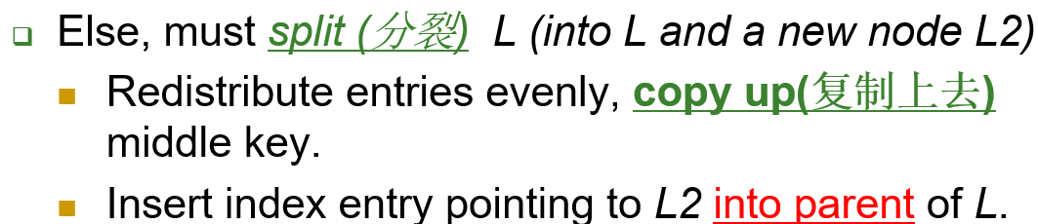
Animation: Insert 8*
<search key value, page id>
8*
分隔符
Root
13
17
24
30
2*
3*
5*
7*
14*
19*
20*
22*
24*
27*
29*
33*
34*
38*
39*
14
16*
5

Slide 17
Final B+ Tree - Inserting 8*
<search key value, page id>
Root
Root
17
13
17
24
30
5
13
24
30
2*
3*
5*
7*
8*
14*
16*
19*
20*
22*
24*
27*
29*
33*
34*
38*
39*
2*
3*
5*
7*
14*
16*
19*
20*
22*
24*
27*
29*
33*
34*
38*
39*
Notice that root was split, leading to increase in height.
In this example, we can avoid split by re-distributing(重分布) entries; however, this is usually not done in practice.
优先分裂，以尽快长大
Notes:
13

Slide 18
Data vs. Index Page Split
(from previous example of inserting “8*”)
<search key value, page id>
Data Page Split
2*
3*
5*
7*
8*
Observe how minimum occupancy is guaranteed in both leaf and index page splits.
Note difference between copy-up and push-up; be sure you understand the reasons for this.
Entry to be inserted in parent node.
…
5
(Note that 5 is
s copied up and
continues to appear in the leaf.)
每个 k* 必须在叶子页中出现一次
2*
3*
5*
7*
8*
Index Page Split
30
5
13
17
24
Entry to be inserted in parent node.
17
(Note that 17 is pushed up and
only appears once in the index.
Contrast this with a leaf split.)
在索引项中,键值k视为分隔符，
而每个键值k在索引节点中只需出现一次
5
13
24
30
Notes:
12

Slide 19
Deleting a Data Entry from a B+ Tree
d <= m <= 2d
Start at root, find leaf L where entry belongs.
Remove the entry.
  If L is at least half-full, done!
  If L has only d-1 entries,
    Try to re-distribute(重分布), borrowing from sibling (adjacent node with same parent as L).
    If re-distribution fails, merge (合并) L and sibling.
If merge occurred, must delete entry (pointing to L or sibling) from parent of L.
Merge could propagate to root, decreasing height.
Notes:
14

Slide 20
Example Tree (Insert 8*)
Delete 19* and 20* ...
Root
Root
13
17
17
24
30
5
13
24
30
2*
3*
5*
7*
14*
16*
19*
20*
22*
24*
27*
29*
33*
34*
38*
39*
2*
3*
5*
7*
8*
14*
16*
19*
20*
22*
24*
27*
29*
33*
34*
38*
39*
Notes:
13

Slide 21
Example Tree (including 8*)
Delete 19* and 20* ...
分隔符
Root
17
5
13
24
30
2*
3*
5*
7*
8*
14*
16*
19*
20*
22*
24*
27*
29*
33*
34*
38*
39*
Deleting 19* is easy.
Deleting 20* is done with re-distribution(重分布). Notice how middle key is copied up.
Notes:
15

Slide 22
Example Tree (including 8*)
Delete 19* and 20* ...
分隔符
Root
17
5
13
27
30
2*
3*
5*
7*
8*
14*
16*
22*
24*
27*
29*
33*
34*
38*
39*
Deleting 19* is easy.
Deleting 20* is done with re-distribution(重分布). Notice how middle key is copied up.
Notes:
15

Slide 23
... And Then Deleting 24*
Must merge.
Observe `toss(删除)’ and `pull down’(拉下来) of index entry
Root
17
5
13
27
30
2*
3*
5*
7*
8*
14*
16*
22*
24*
27*
29*
33*
34*
38*
39*
Root
17
5
13
30
2*
3*
5*
7*
8*
14*
16*
22*
27*
29*
33*
34*
38*
39*
Notes:
16

Slide 24
... And Then Deleting 24*
Must merge.
Observe `toss(删除)’ and `pull down’(拉下来) of index entry
Root
(…, 17)
17
分隔符
[17, …)
5
13
30
[13, …)
(…, 30)
2*
3*
5*
7*
8*
14*
16*
22*
27*
29*
33*
34*
38*
39*
键值k视为分隔符
Root
5
13
17
30
[13, 17)
[17, 30)
2*
3*
5*
7*
8*
14*
16*
22*
27*
29*
33*
34*
38*
39*
Notes:
16

Slide 25
Example of Non-leaf Re-distribution
Tree is shown below during deletion of 24*. (What could be a possible initial tree?)
In contrast to previous example, can re-distribute entry from left child of root to right child.
Root
分隔符
22
键值k视为分隔符
5
13
17
20
30
2*
3*
5*
7*
8*
14*
16*
17*
18*
20*
21*
22*
27*
29*
33*
34*
38*
39*
Notes:
17

Slide 26
After Re-distribution
Intuitively, entries are re-distributed by `pushing through(推转)’ the splitting entry in the parent node.
  It suffices to re-distribute index entry with key 20; we’ve re-distributed 17 as well for illustration.
Root
分隔符
17
键值k视为分隔符
5
13
20
22
30
2*
3*
5*
7*
8*
14*
16*
17*
18*
20*
21*
22*
27*
29*
33*
34*
38*
39*
Notes:
18

Slide 27
Bulk Loading of a B+ Tree
批量(/块)加载B+树
Given: large collection of records
Desire: B+ tree on some field
Bad idea: repeatedly insert records
  Slow, and poor leaf space utilization . Why?
Bulk Loading can be done much more efficiently.
Initialization: Sort all data entries, insert pointer to first (leaf) page in a new (root) page.
Root
Sorted pages of data entries; not yet in B+ tree
3*
4*
6*
9*
10*
11*
12*
13*
20*
22*
23*
31*
35*
36*
38*
41*
44*
Notes:
20

Slide 28
Bulk Loading (Contd.)
Root
10
20
Index entries for leaf pages always entered into right-most index page just above leaf level.
  When this fills up, it splits.
    Split may go up right-most path to the root.
Much faster than repeated inserts.
Data entry pages
6
12
23
35
not yet in B+ tree
3*
4*
6*
9*
10*
11*
12*
13*
20*
22*
23*
31*
35*
36*
38*
41*
44*
Root
20
10
35
Data entry pages
not yet in B+ tree
6
12
23
38
3*
4*
6*
9*
10*
11*
12*
13*
20*
22*
23*
31*
35*
36*
38*
41*
44*
Notes:
21

Slide 29
A Note on `Order’(秩) d <= m <= 2d 最小占有率
通常淡化,Use a physical criterion(物理空间标准) in practice (`at least half-full’).
  Index pages often hold many more entries than leaf pages.
  Variable sized records and search keys:
    different nodes have different numbers of entries.
  Even with fixed length fields, Alternative (3) gives variable length
Notes:
22

Slide 30
Summary
Tree-structured indexes are ideal for range-searches, also good for equality searches.
ISAM is a static structure.
  Only leaf pages modified; overflow pages needed.
  Overflow chains can degrade performance unless size of data set and data distribution stay constant.
B+ tree is a dynamic structure.
  Inserts/deletes leave tree height-balanced; log _{F} N cost.
  High fanout (F) means depth rarely more than 3 or 4.
  Typically, 67% occupancy on average.
  Usually preferable to ISAM; adjusts to growth gracefully.
  缺点:If data entries are data records, splits can change rids!
Notes:
23

Slide 31
Summary (Contd.)
Key compression(键压缩) increases fanout, reduces height.
Bulk loading can be much faster than repeated inserts for creating a B+ tree on a large data set.
要求: 掌握 B+ 树索引的构建方法,即插入与删除
Notes:
24

